Slide 1

YBTH CODERS
Maharaja Agrasen Institute of Technology

Slide 2



OUR TEAM
Nishant Rajput
Swastik Jain
Shivangi Mishra

Slide 3



Idea Introduction
IDEA - OUTCOME – HEADLINE
The idea is to develop a tracking and authorization system for all types of vehicles. It can be used as a vehicle monitoring application to identify high speed vehicles and in heavy traffic areas.

Slide 4

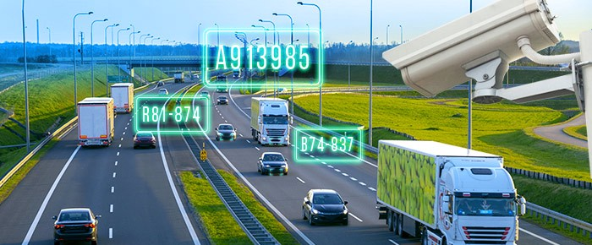
Approach
Observance and Targeting the Problem:
In today’s fast paced world, due to the rising number of accidents and rules violations, there arises a need of an automated system to monitor on-road activities.
Additional Features:
Alternatively, the vehicles can be tracked using their last timestamp retrieved from the system. It can be further extended to include authorization as well.
Future Scope:
It can be further scaled by integrating multiple modules working together as a combined application.

Slide 5

Development Pipeline
Step 1
Requirement Specification
Research
Data Collection
Step 3
Model Training
Model Validation
Step 2
Data Preprocessing
Data Annotations
Step 4
Final Implementation
Monitoring and Maintenance

Slide 6
Identification: Fast Recognition of a vehicle number plate is the basis for fast and seamless vehicle identification. The identification can be used to grant vehicle access or find and track specific vehicles.
1
Efficiency:The precise and Fast number plate recognition doesn’t rely on human input. Thereby, it leads to a cost-efficient governance and reduces waiting times.
Vision of Innovation
2
Flexibility : The setup is highly integrable which results to a flexible system. It can be easily scaled for mass use. We can use it as an alternative to the current global positioning system by utilising the ANPR data.
3

Slide 7
ANY QUESTIONS?

